Slide 1
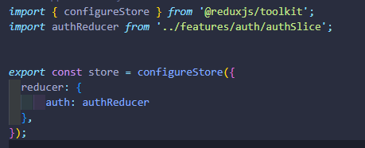
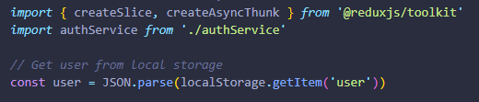
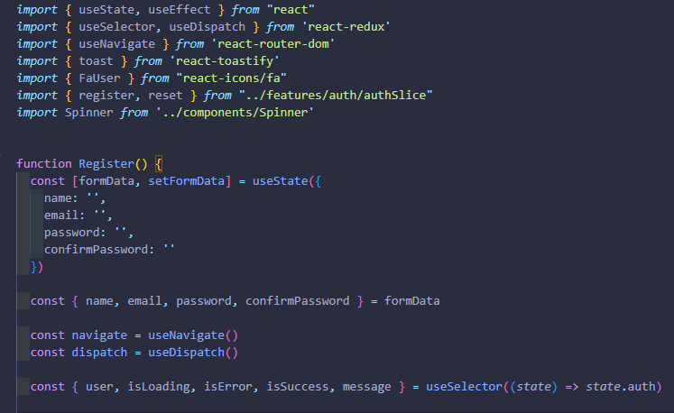
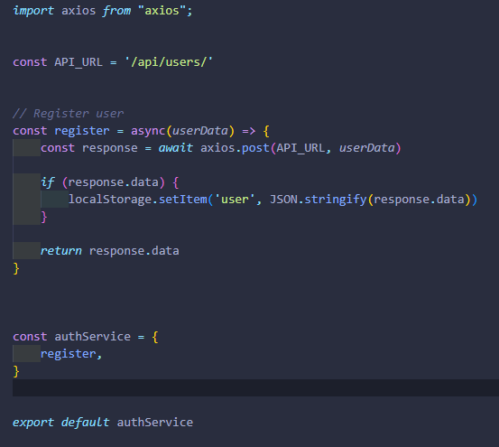
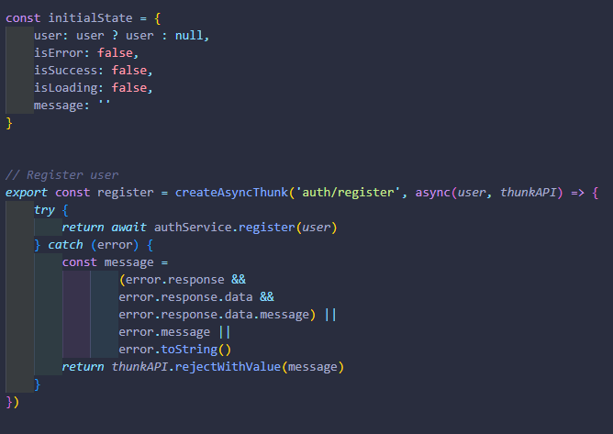
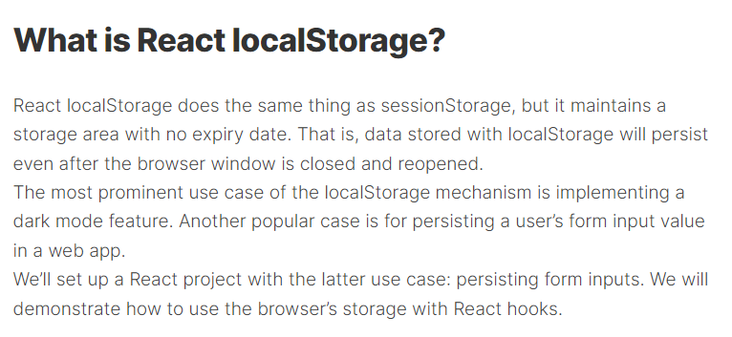
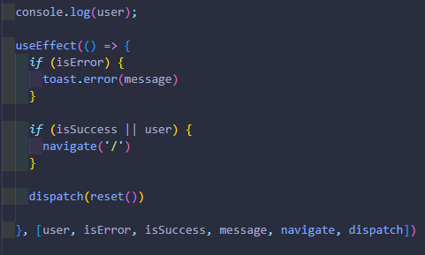
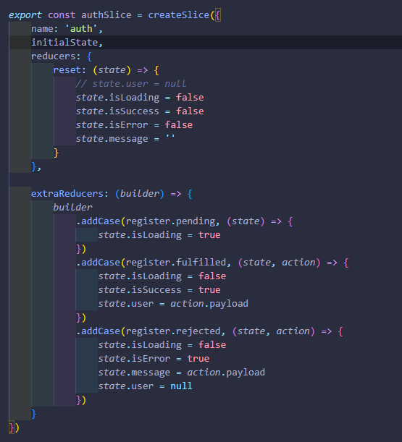
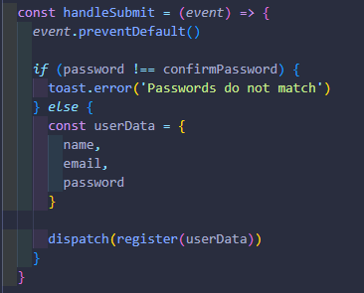
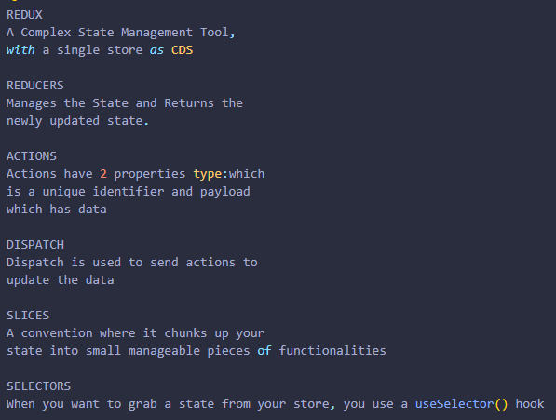

store.js
authSlice.js
Register.jsx
authService.js
‘authReducer’ can be renamed to anything
Slice contents
name
initialState
Reducers
Methods to modify state
extraReducers
Methods to modify state
reducers are methods that you can call on your slice to modify the state can add many methods as you want
will be exported out and imported to store
Definition of Terms
The reducers property both creates an action creator function and responds to that action in the slice reducer. The extraReducers allows you to respond to an action in your slice reducer but does not create an action creator function.
You will use reducers most of the time.
You would use extraReducers when you are dealing with an action that you have already defined somewhere else.
The most common examples are responding to a createAsyncThunk action and responding to an action from another slice.
actions are what you are going to be calling in your jsx components to change your state

